Slide 1

CSCI 4502/5502
Data Mining - Fall 2023 - Lecture 19
Ravi Starzl, PhD

Slide 2

Fall 2023 Practice Questions
Q1: True or false (4 x 5)
Q2: Brief answers (4 x 5)
Q3: Correlation (20)
Q4: Frequent itemsets (20 + 5*) (10 + 10)
Q5: Classification (10 + 10)
Q6: Clustering (5*)
Ravi Starzl, PhD - Data Mining Fall 2023

Slide 3

Q1: True or False
Determine if the following statements are true or false. Briefly explain why.
Ravi Starzl, PhD - Data Mining Fall 2023

Slide 4
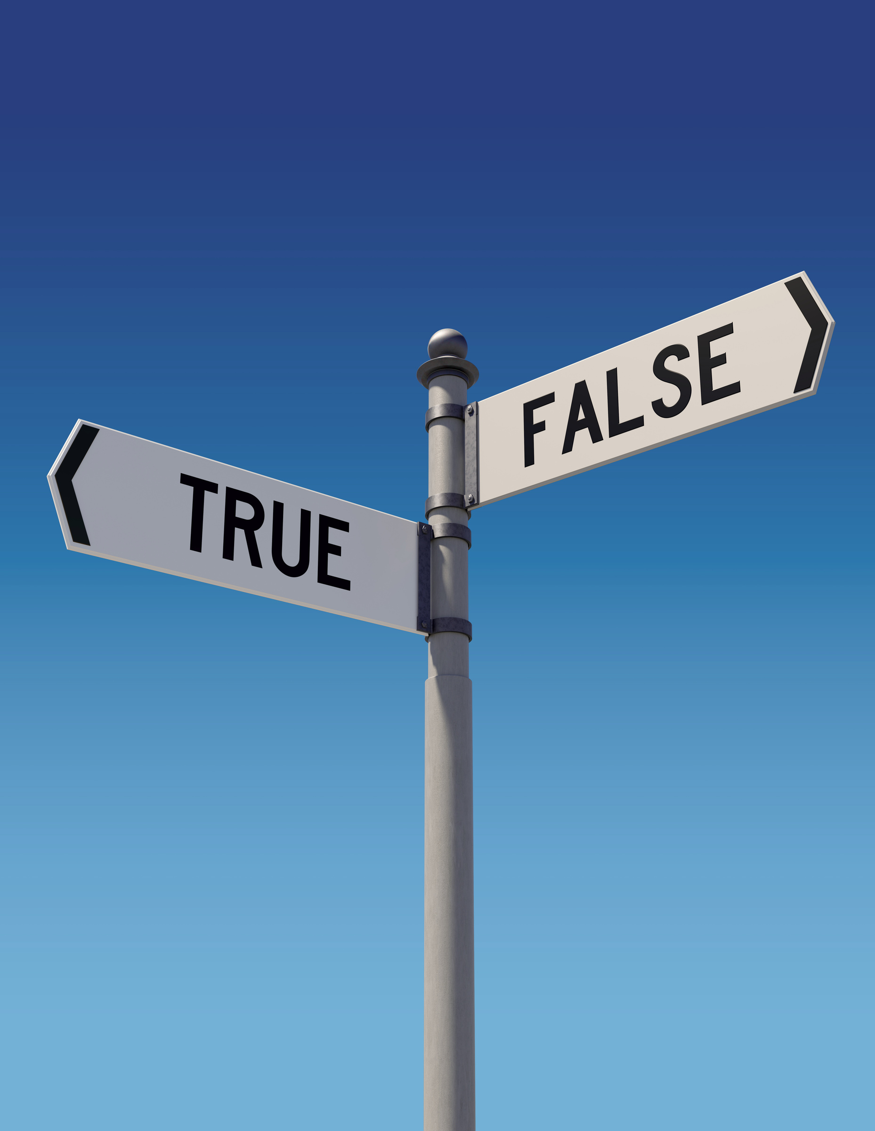
Q1: True or False
(a) A scatter plot can only show positive correlation between two variables.
FALSE. A scatter plot shows two variables as x and y axes. It can show positive, negative, or no correlation.
Ravi Starzl, PhD - Data Mining Fall 2023

Slide 5

Q1: True or False
(b) RANGE(S.price) ≥ v is both monotonic and antimonotonic, where RANGE(S.price) is the difference between maximum and minimum item price in itemset S.
FALSE. Anti-monotonicity states that if S violates the constraint, then S+ must also violate the constraint. RANGE(S+.price) >= RANGE(S.price). Even if RANGE(S.price) < v, when more items are added, RANGE(S+.price) can be >= v. As such, this constraint is NOT anti-monotonic.
Ravi Starzl, PhD - Data Mining Fall 2023

Slide 6

Q1: True or False
(c) The decision tree induction method cannot support incremental data.
TRUE. The decision tree induction method is a top-down approach. It chooses at each level the attribute to use and the data are split by branches. When new data are added, we need to redo the whole process from the top level.
Ravi Starzl, PhD - Data Mining Fall 2023

Slide 7

Q1: True or False
(d) The k-means clustering method cannot identify clusters of arbitrary shapes.
TRUE. The k-means clustering method assigns each object to the nearest centroid. As such, it can only identify clusters of convex shapes.
Ravi Starzl, PhD - Data Mining Fall 2023

Slide 8

Q2: Brief Answers
Provide a brief answer for each of the following questions.
Ravi Starzl, PhD - Data Mining Fall 2023

Slide 9

Q2: Brief Answers
✦(a) What are the four different views of data mining?
Data, knowledge, method, application
Ravi Starzl, PhD - Data Mining Fall 2023

Slide 10

Q2: Brief Answers
(b) What are the main steps in the data mining pipeline?
data understanding, preprocessing, warehousing, modeling, evaluation
Ravi Starzl, PhD - Data Mining Fall 2023

Slide 11

Q2: Brief Answers
(c) Identity three differences between OLTP and OLAP.
OLTP (Online Transaction Processing): daily operation, current data, real-time processing, data updates, …
OLAP (Online Analytical Processing): decision support, historical data, longer processing time, nonvolatile, …
Ravi Starzl, PhD - Data Mining Fall 2023

Slide 12
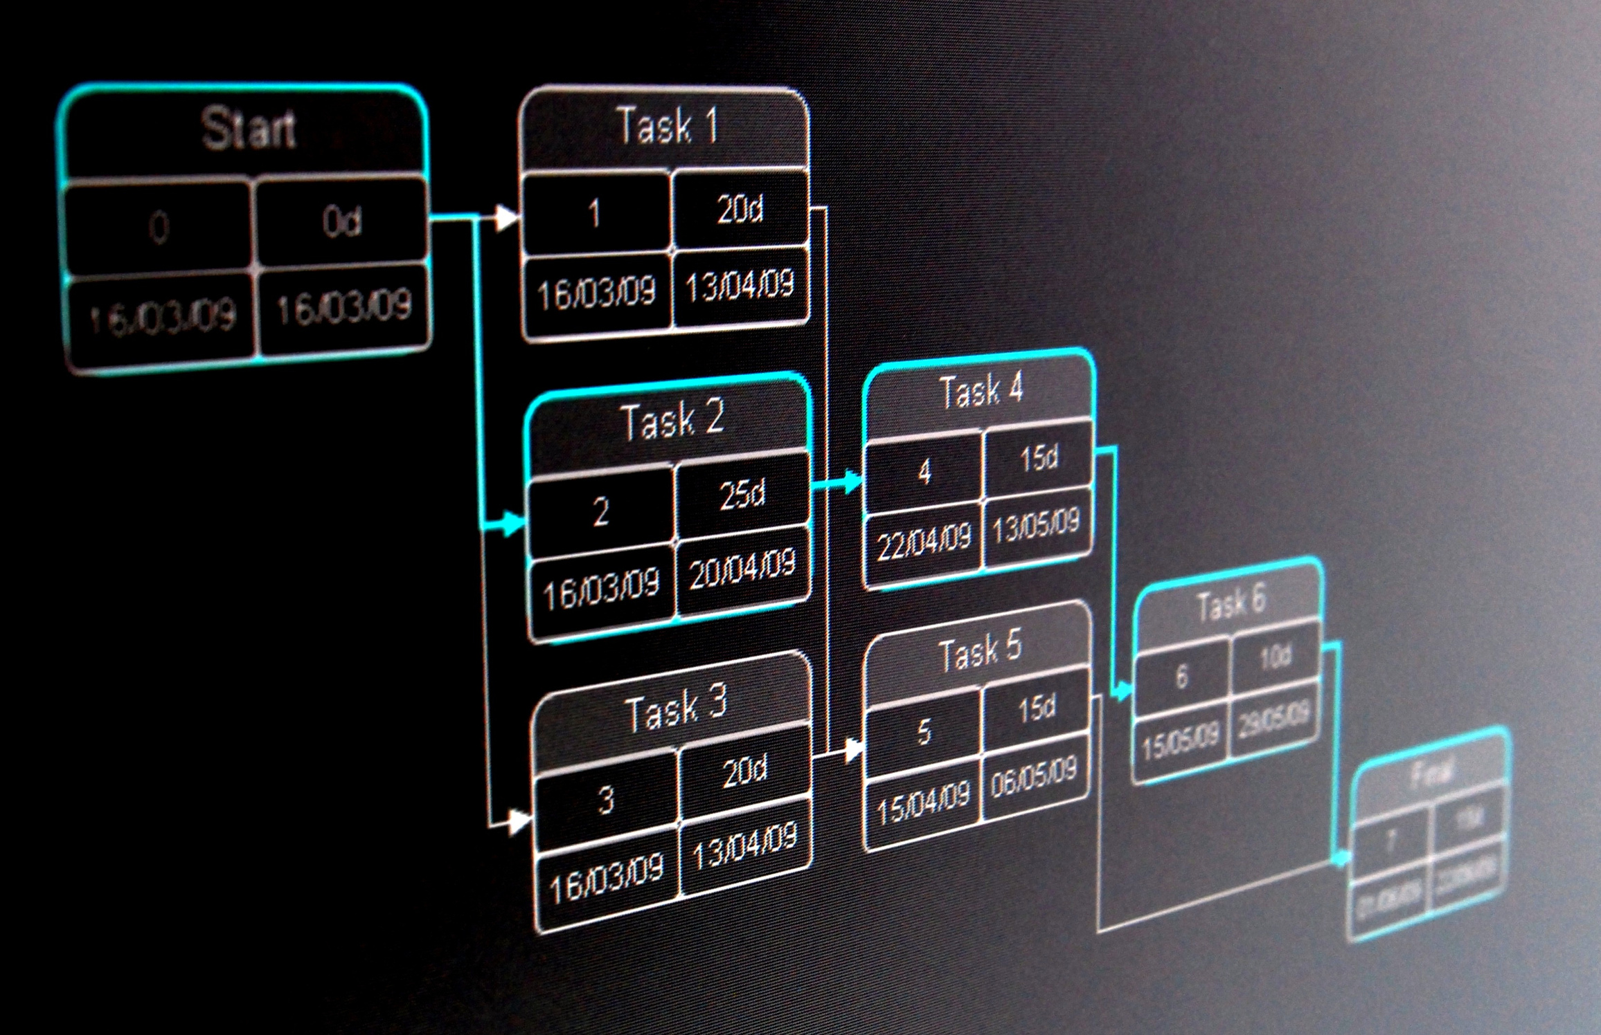
Q2: Brief Answers
(d) Name the two types of ensemble methods and explain their key difference.
bagging: equal weight when combining multiple models
boosting: different weights for different models
Ravi Starzl, PhD - Data Mining Fall 2023

Slide 13
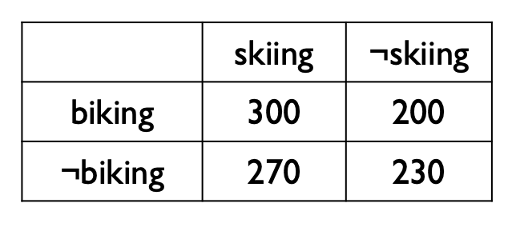
Q3: Correlation
Consider the 2 × 2 contingency table summarizing a student population with respect to biking and skiing.
(a) Compute the lift value.
(b) Compute the X^2 value.
Ravi Starzl, PhD - Data Mining Fall 2023

Slide 14

Q3: Correlation
(a) lift(A, B)
(300/1000) / ((500/1000) x (570/1000)) ✦(b) Chi-square analysis
chi-square value
expected values,
e_11 = 500 x 570 / 1000, e_10, e_01, e_00
(300-e_11)^2/e_11 + (200-e_10)^2/e_10 + (270-e_01)^2/e_01 + (230-e_00)^2/ e_00
Ravi Starzl, PhD - Data Mining Fall 2023

Slide 15

Q3: Correlation
(c) Are both correlation measures null-invariant? Briefly explain why.
Null-invariant: metric is not impacted by the null transactions (i.e., not biking and not skiing).
Both life and X^2 consider the null transactions in their calculations, thus are NOT null-invariant.
Ravi Starzl, PhD - Data Mining Fall 2023

Slide 16
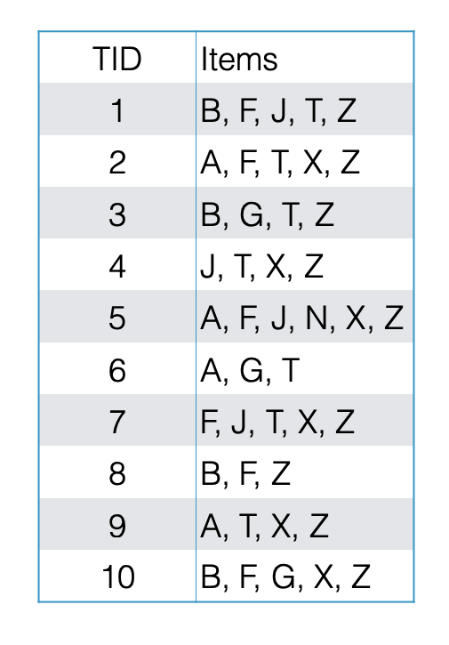
Q4: Frequent Itemsets
Consider the market basket transactions shown in the table.
(a) Let min_support = 45%, find all frequent itemsets using the Apriori algorithm.
10 * 45% = 4.5
frequent: at least 5 occurrences

Slide 17
Q4: Frequent Itemsets
1-itemsets
F:6, T:7, X:6, Z:9, A:4, B:4, G:3, J:4, N:1
2-itemsets
FZ:6, TZ:6, XZ:6, FT:3, FX:4, TX:4
3-itemsets none (no candidate)

Slide 18
Q4: Frequent Itemsets
(b) Draw the corresponding FP-tree for this data set.
sort by frequency
Z:9, T:7, F:6, X:6
A:4, B:4, G:3, J:4, N:1 are infrequent ✦ support values
node links

Slide 19
Q4: Frequent Itemsets
(b) Draw the corresponding FPtree for this data set.
{} => {Z:9}, {T:1}
{Z:9} => {T:6}, {F:3}
{F:3} => {X:2}
{T:6} => {F:3}, {X:2}
{F:3} => {X:2}
node links:
Z:9 => {Z:9}
T:7 => {T:6} => {T:1}
F:6 => {F:3} => {F:3}
X:6 => {X:2} => {X:2} => {X:2}

Slide 20

Q5: Classification
Consider the training examples shown in the table for a binary classification problem of the class label “Picnic”.
(a) Using decision tree induction, write out the steps for computing the information gain for the “Temp” attribute. Given the information gain values of two attributes, do we select the attribute with higher information gain or lower information gain for decision tree classification? Briefly explain why.

Slide 21
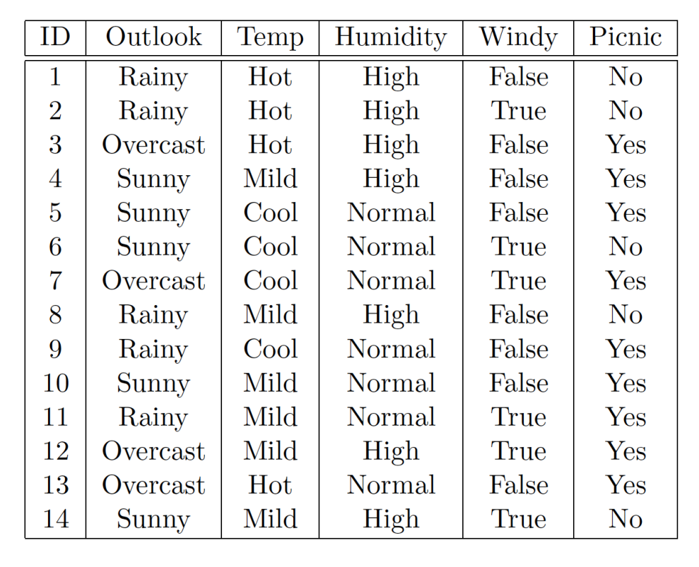
Q5: Classification
Classes: Yes or No
D: 14(9, 5)
Temp
Hot: 4(2, 2)
Mild: 6(4, 2)
Cool: 4(3, 1)

Slide 22

Q5: Classification
Information gain
Info(D) = I(9, 5) = - 9/14 log_2(9/14) - 5/14 log_2(5/14)
Info_Temp(D) = 4/14xI(2, 2) + 6/14xI(4, 2) + 4/14xI(3, 1)
Info(D) - Info_Temp(D)
Choose attribute with higher information gain
lower information means purer (more uniform) class distribution
higher information gain: larger information reduction, lower information

Slide 23

Q5: Classification
Consider the training examples shown in the table for a binary classification problem of the class label “Picnic”.
(b) Using naive Bayes classifier, write out the steps for classifying “Picnic” as Yes or No for X = (Outlook = Overcast; Temp = Mild;Humidity = High;Windy = False).

Slide 24

Q5: Classification
X = (Outlook = Overcast; Temp = Mild; Humidity = High; Windy = False)
P(Yes) = 9/14, P(No) = 5/14
P(Yes|X) = P(X|Yes)P(Yes)/P(X)
P(Outlook=Overcast|Yes) x P(Temp=Mild|Yes)
P(Humidity=High|Yes) x P(Windy=False|Yes) x
P(Yes)
= 4/9 x 4/9 x 3/9 x 6/9 x 9/14 can ignore P(X)

Slide 25

Q5: Classification
X = (Outlook = Overcast; Temp = Mild; Humidity = High; Windy = False)
P(No|X) = P(X|No)P(No)/P(X)
P(Outlook=Overcast|No) x P(Temp=Mild|No)
P(Humidity=High|No) x P(Windy=False|No) x P(No)
= 0/5 x 2/5 x 4/5 x 2/5 x 5/14 can ignore P(X)
zero probability: (0 overcast, 3 rainy, 2 sunny) => (1, 4, 3) => 1/8

Slide 26

Q6: Clustering
Consider the following set of one-dimensional points: {70, 150, 180, 40, 80, 210, 30, 60}.
(a) Show the first round of k-means clustering method to generate two clusters, assuming the initial centroids are 50 and 100, respectively.
Sort the data: {30, 40, 60, 70, 80, 150, 180, 210}
R1: 50 {30, 40, 60, 70}, 100 {80, 150, 180, 210}
C_1 = (30+40+60+70) / 4 C_2 = (80+150+180+210) / 4

Slide 27

Q6: Clustering
Consider the following set of one-dimensional points: {70, 150, 180, 40, 80, 210, 30, 60}.
(b) What is the computation complexity of k-means clustering? Briefly explain why.
O(knt): for each of the t iterations, for each of the n objects, for each of the k centroids, we compute the distance of the object to the centroid, and assign the object to its nearest centroid.

Slide 28
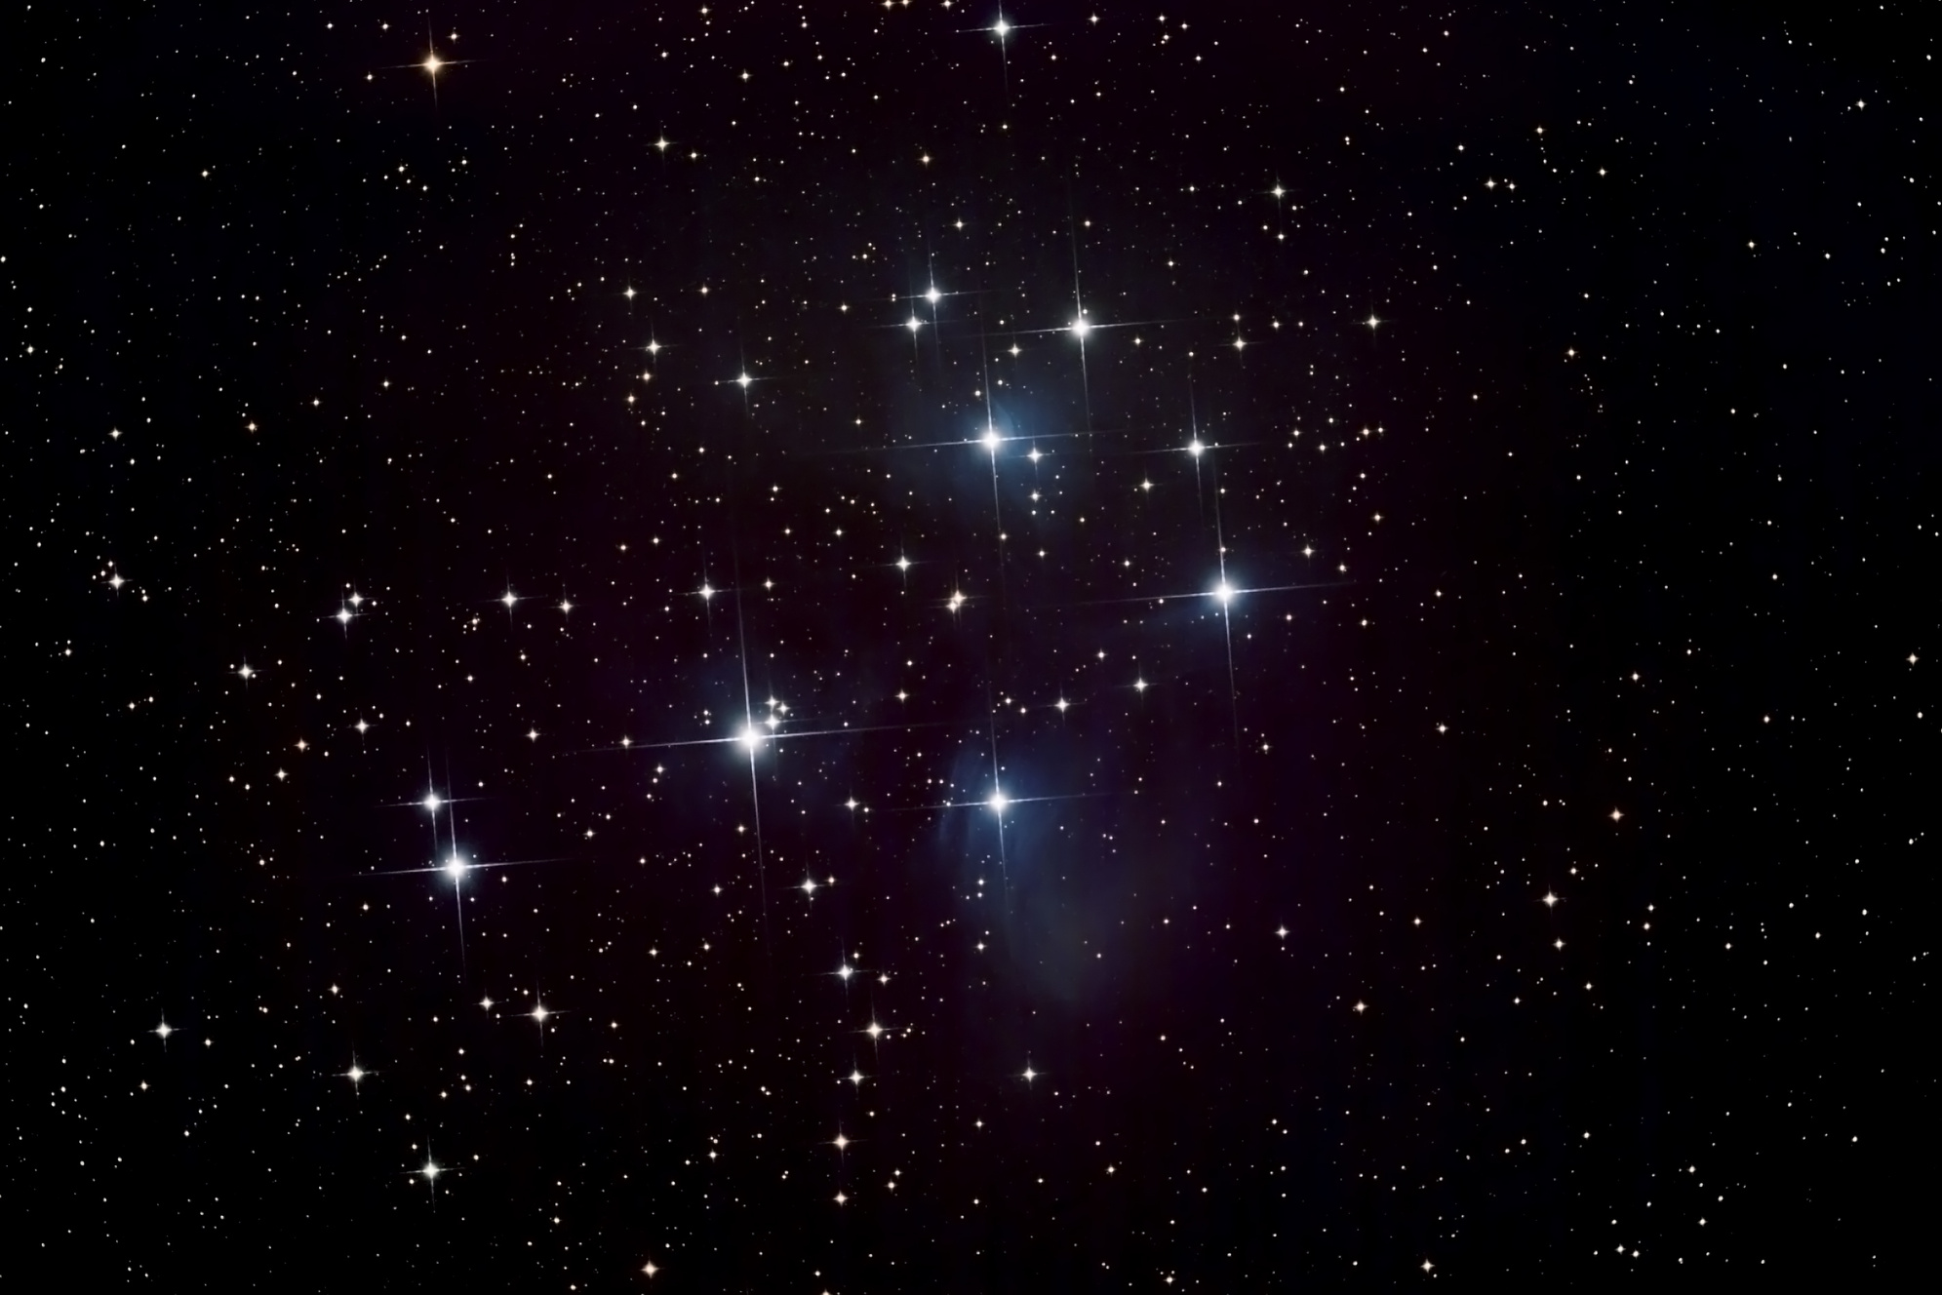
Q6: Clustering
Consider the following set of one-dimensional points: {70, 150, 180, 40, 80, 210, 30, 60}.
(c) Given two different sets of initial centroids, does the kmeans method always generate the same clustering results when it terminates?
No. k-means clustering is a heuristic method and terminates at local optimum. As such, different sets of initial centroids may result in different clustering results.

